Slide 1

Arduino-Based Radar System
Welcome to the presentation on a radar system designed using Arduino, servo motor, and sonar sensor. The project explores the core principles of radar technology and demonstrates the practical implementation using a compact and cost-effective setup.

Slide 2
Project Overview
Objective
Project Summary
To design and implement a radar system capable of detecting objects using sonar sensors and visualizing the data.
This project aims to build a radar system using a servo motor and sonar sensor. The radar scans the environment, measures distances to objects, and displays the data on a user-friendly interface.

Slide 3
Theory and Working Principle
1
Radar Fundamentals
2
Sonar Sensor Basics
3
Servo Motor Usage
Radar systems use electromagnetic waves or sound waves to detect objects. Ultrasonic radar systems use sound waves.
Ultrasonic sensors transmit sound waves and measure the time it takes for the waves to reflect back, providing distance measurements.
A servo motor enables the sonar sensor to rotate, covering a wider range of angles, creating a more comprehensive scan of the environment.
The ultrasonic sensor is mounted on a rotating servo motor, allowing it to scan the surrounding area up to a distance of approximately 200 cm.
No Object Detected: If there is no object within the specified range (e.g., 40 cm), the radar display shows all green lines, indicating a clear area.
Object Detected: When an object is detected within the 40 cm range, the sensor identifies it, and red lines appear on the radar display, signaling an obstacle.
This setup enables real-time monitoring and visualization of objects within the sensor’s detection range.

Slide 4
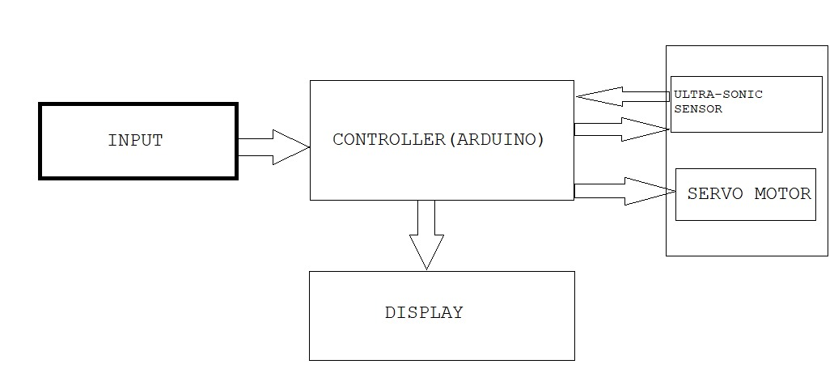
Project Approach and System Design
Block Diagram
The system comprises an Arduino microcontroller, a servo motor, a sonar sensor, and a display or PC.

Slide 5
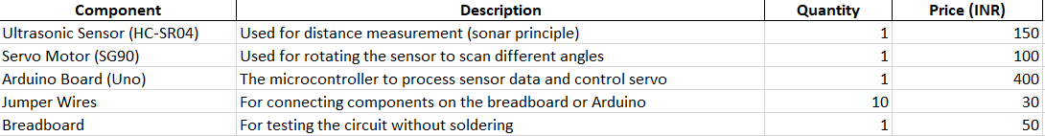
Component price analysis
Hardware
Software
Arduino Uno, servo motor (SG90), ultrasonic sensor (HC-SR04), Connecting wires, Breadboard, optional display or PC.
Arduino IDE, Processing ( for PC visualization).

Slide 6
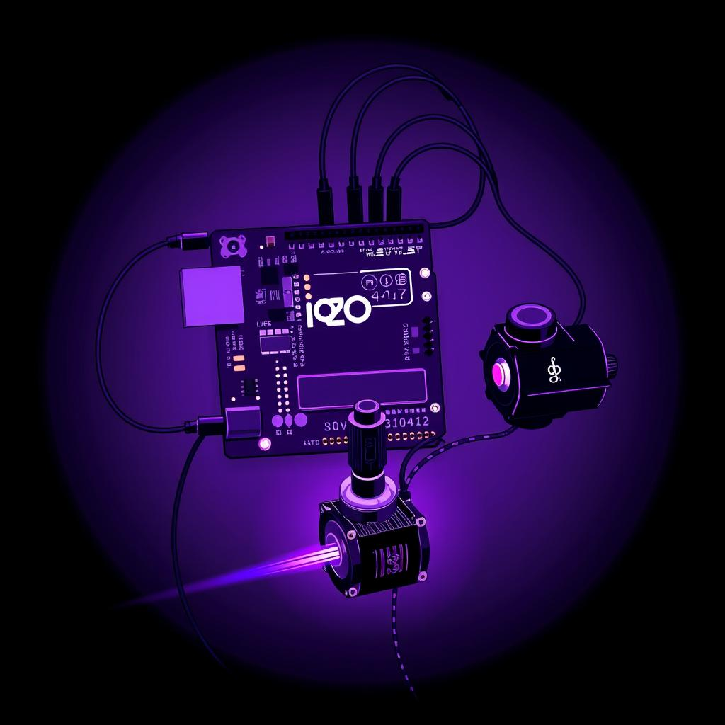
Project Timeline
1
Week 1-2
Research, component procurement, and project planning.
2
Week 3-4
Hardware setup, initial Arduino coding, and basic functionality testing.
3
Week 5-6
Integration of sonar sensor and servo motor, testing and optimization.
4
Week 7
Final testing, setup for data visualization, and refining the code.
5
Week 8
Final adjustments, documentation, and presentation preparation.

Slide 7


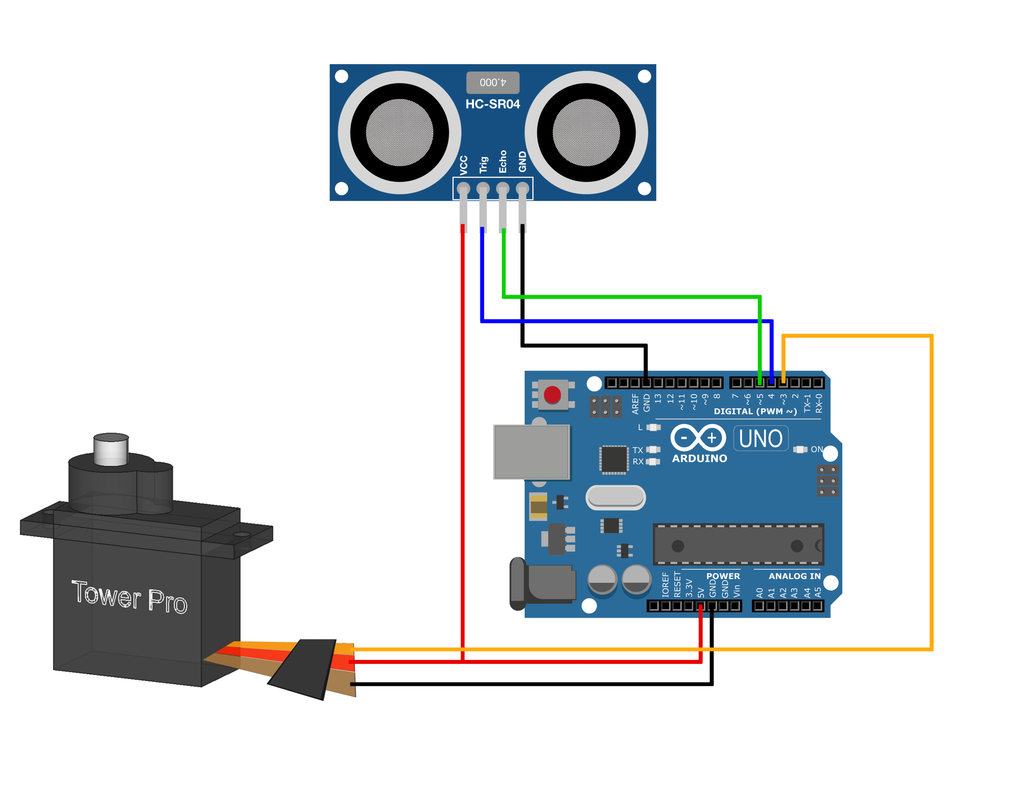
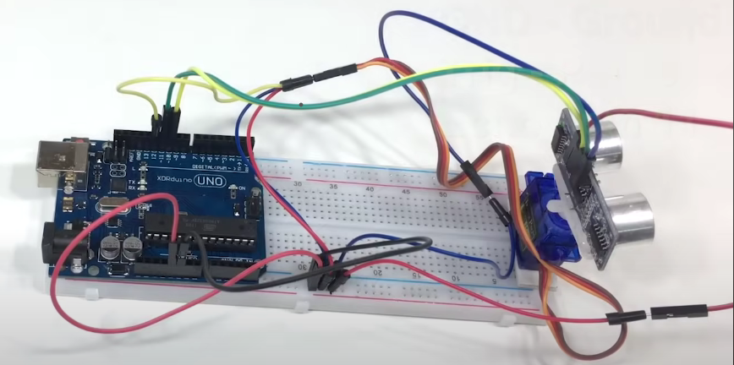
Circuit Diagram and Wiring
Wiring Diagram
Component Connections
Arduino digital pins are used to control the servo motor and receive data from the sonar sensor.
The Arduino sends commands to the servo motor to rotate the sonar sensor and receives distance measurements from the sensor.

Slide 8
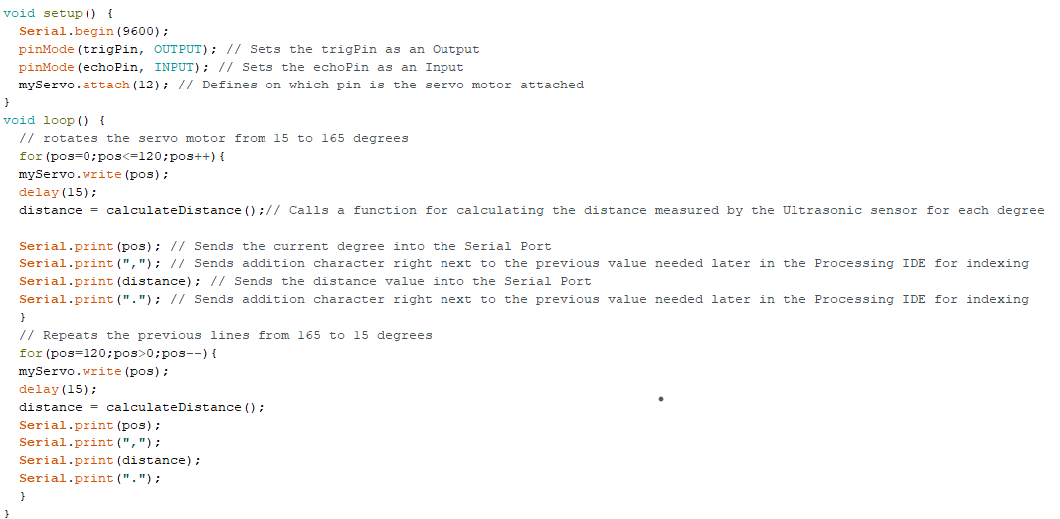
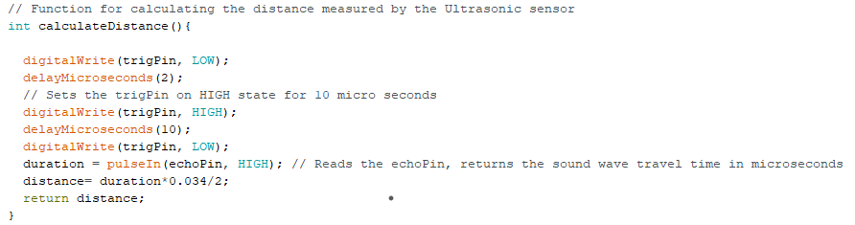
Coding Overview
Servo Motor Control
Sonar Data Acquisition
The code sets up the servo motor, rotates it through a predefined angle, and sends commands to the sonar sensor.
The code reads data from the sonar sensor, calculates the distance to objects, and stores the data for further processing.

Slide 9



Expected Outcome and Limitations
Real-time Detection
1
The system detects objects in real time, providing instant readings of their distance and angular position.
Data Visualization
2
The data is visualized on a display or PC, providing a clear representation of the environment.
Limitations
3
Limitations include limited range, potential for environmental noise interference, and accuracy limitations.

Slide 10




References
YouTube
https://www.youtube.com/c/indianlifehacker
GitHub Documentation
https://github.com/NimishaChitriv/Ultrasonic_radar
Research Papers
https://www.ijnrd.org/papers/IJNRD1804002.pdf
https://www.researchgate.net/publication/373216250_Project_Report_on_Ultrasonic_Radar_System

